Slide 1
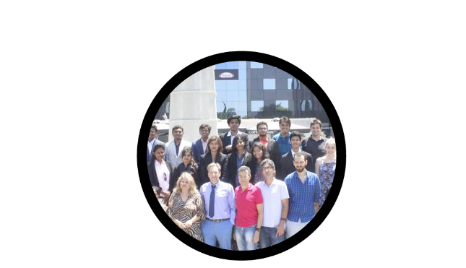
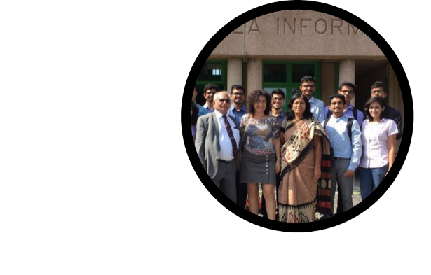
Technology Business Incubation through Industry-Academia Integration
Dhananjay : Director - Business Incubation Center
Vishwaniketan – Management, Engineering & Entrepreneurship

Slide 2
Contents
- India – Opportunity and Prospects - India Start ups – Statistics and Strategy - Prospects for Universities & industry - Approach & Lifecycle - Our capability & infrastructure - Right talent for bright commerce - Approach for opportunity harvesting - Options for Trade & Commerce - Key links for trade statistics - Open Forum – Suggestions for Co-operation
01

Slide 3
India : Opportunity and Prospects
Energetic mass of 1.3 billion .. half billion workforce, 200 million middle income
Major triggers : Revival of Indo–Russian relations, Geo-political aspects
Govt. Reforms & India image – avenues for tech. transfer
Fastest growing economy .. GDP USD 2 Trillion .. Growing @ 7.5 %
Services: 65%, Industry: 20%, Agriculture: 15%
Major Sectors - FDI : Services, Construction, IT, Telecom, Auto, Pharma – Ayurveda
Large pool of skilled & cheap manpower; significant English speaking
Median age of 35 years, population in working age group to be approx. 50% by 2020
Huge untapped market potential, urban population to touch 590 million by 2030
Scope for foreign universities
Foreign companies setting up facilities due to reforms & initiatives : Make in India and Digital India
Strong Engg studies but weaker research base – less real products versus science projects
Vast Indian market for specific product development and also for export to other countries
02

Slide 4
Startups – Statistics and Strategy
India : ‘Start-up nation’
3rd in Global Eco-system, 4000 Start-ups / year .. Foreign VC Investment : USD 8 billion
Average age of founders : 30 years. 120+ Incubation centers
Key areas - Online services – IoT, Healthcare, Finance; Trading, Niche technologies, Real estate
Academia – ideal platform to promote Incubation center & Start-up
4000 Engineering colleges train 15 lakh engineers
Great opportunity
Focus areas : Power, Bio-tech, Mfgr., Infrastructure, Agri-business, Healthcare
Produce for Indian & global market at competitive rates
Education & Manufacturing sectors opening up – scope for technology investment
Foreign partners will need good hosts with global reach
03

Slide 5
Prospects for foreign universities & industry
Specific scope for technical collaboration
Major tech : industry & business center
Powerful research center .. Proven Industry-Academia collaboration
Innovation Infrastructure – Marketing, Centre of Tech Transfer & Entrepreneurship
Center for Innovative Enterprises – over 100 ent. created to commercialize research
High quality technology + Cheap mfgr cost = affordable products – real value for money
Knowledge transfer to Indian Start-ups / Joint Ventures
Economical cost of products due to high volume and low labour & infra cost
Ideal Joint venture eco-system
Institutions to fully represent & support each other in own countries
Niche CIS technology + low cost & high quality Indian labour = world-class products
04

Slide 6
Approach & lifecycle
Vishwaniketan TBI Company – ‘Umbrella’ Entity
Individual staff members, students to form Start-ups underneath
Setup
Infrastructure
Logistics
Attract
Promotions
Scrutiny
Incubate
Mentor
Approvals
Selection
Planning
Finance
Networking
Launch
Market Research
Marketing
Distribution
Revenue Management
Invite Applications
Up to 6 months
Till 12 months
Ongoing
Up to 36 months
05

Slide 7
Our Capability & Infrastructure
Founded by Academicians & Professionals
Immense interest in practical education, based on real problems / projects and solutions
Network & eco-system of 25 Indian & 15 foreign colleges + 25,000 students
300+ Engg. students completed fellowship abroad .. 500 due next year
70 professionals & senior teachers completed Ph.D. abroad
Infrastructure for business incubation
60,000 sq. ft. premises on 20 acre land at Khalapur along Mumbai-Pune Expressway
Close to upcoming airport and a major economical hub & MIDC
Over 2000 budding Engineers and 100 senior staff backed by SMEs from industry
Capability
Substantial funds and scalable infrastructure / premises
Regular connect with MIDC Management, Govt. agencies, Service Integrators
Agreement with Govt. for skill development
Quality education + training in Innovation centers to support the start-ups
End to end assistance to Start-ups / JV in India
06

Slide 8
Organization Structure of VIC
07

Slide 9
Maslov Theory of human growth
8

Slide 10
Team building initiatives
Set up of development unit for Mobile & Cloud Apps
Hub for system design & consulting – Custom apps, SAP, Magic SW
Crowd-sourcing of business ideas
Promote technology fairs / Expos for optimum Corp. “Match making”
Assessment of TBI avenues at all Partner universities
Training UG Fellowship staff for scoping of tech. ventures
Initiate early dialogue with SPOCs of Partner Universities
Plan : One to One discussions with local companies to qualify leads
Staff to further qualify the business leads in 45 day Internship
9

Slide 11
Right talent for bright commerce
Majority engineers & professionals are not job-ready
Aim for great career in own start up with us
Higher you go, better work-life balance
Achieve Greater returns & better life
World as a play ground with connects and experience!
Utilize network and experience to be SME
Specialize in niche area in PG,
Part-work in related field
Firm up knowledge during graduation
Study in India,
Internships abroad
Take benefits of huge demand for industry-ready pros!
Must be an asset for start-up
10

Slide 12
Business Incubation Process
Application
Incubation
Pre-Incubation
Application
Graduation
Pre-Incubation
Post-Graduation
Idea
Start-up
Enterprise
Successful Venture
Idea Generation
Research
Technology Identification
Awareness $ Development training
Business Plan Preparation Training
Development Training
Submission of business idea
Business idea presentation
Concept validation/ Feasibility study
Signing of MOU
New product/process development
Market development Patent/TM certification
Fund raising
Training & networking
Tech launch
Technology commercialization
Business & growth assessment
Client assessment
Expansion
Graduation plan development
Monitoring
Training
Business Support
Networking
11

Slide 13
Eco-system
12

Slide 14
Approach for Opportunity Harvesting
MoU with universities as India Representative
Promote Under Graduate Internships, MS study & Joint Ph. D.
Market CIS products & tech joint ventures to promote Indian Start-ups
Lines and products
Key areas – Elec., Mech., Electronics, Telecom., Robotics, IT, Energy, Automation
Products – Diamonds & precious stones, laser & diamond tools for cutting / polishing,
ball bearings, petro-chem., exotic fruit & jams, machinery for small & medium businesses
Wines & spirits, Medicinal and aromatic plant / products, Food & beverages
Joint projects and product development – IT, Retail, Healthcare, Global trade
Objectives
Expand business of existing Russian Start-ups in India
Centre of Excellence – Tech transfer and joint manufacture
Promote Start-ups for products for India & Global Market
13

Slide 15
Bonds with Greece
14

Slide 16
Bonds with USA
14

Slide 17
Bonds with Russia
14

Slide 18
Bonds with Ukraine
14

Slide 19
Bonds with Italy
14

Slide 20
Bonds with Bulgaria
14

Slide 21
Opportunity for YOU!
Vishwaniketan IC to facilitate your global technology transfer
Work in progress for “Business Match making ” service across all partner countries
Ready infrastructure + manpower + contacts
Ideal hotbed to evaluate & develop your ideas
Expand your trade globally – Any product Any country
Low risk transactions thru our network
Seek partners abroad and represent them here
15

Slide 22
Options for Trade & Commerce
Key Russian exports to India: Natural or cultured pearls, precious or semi-precious stones, precious metals, machinery, defense hardware, metals & organic chemicals
Key Indian exports : Pharma, tea, coffee, tobacco, machinery, in-organic chem
India - World’s largest producer of dairy products, fruit n vegetables, meat and seafood
Indian textiles and apparel - history of fine craftsmanship
Defense sector opened for companies – scope in laser, optics, metals & chemicals
Tech transfer options – just an indicative list – open for addition!
IT / Security, Big data; Biotech, Life sciences, Robotics, Agriculture tech.
Processing of Fruit, vegetables & dairy products, spices, natural medicines
Medicinal & aromatic plant-products - $ 12 billion market for natural medicines
Diamond & special metal tools / Machinery - medical, auto, aviation, component mfgr
Non-conventional energy – solar wafers & magnets for MagLev wind mills
Dual purpose products for defense sector – clothing, foot-ware, night vision items, etc
Action for us :
List-out Start-ups and products.
We will analyze Indian market and pick up best options.
16

Slide 23
Who am I
M.S. (Comp. Sc.) ‘ 90 – Ukraine Polytechnic University
Advanced Diploma – Local Area Networks – Baumanski University, Moscow
Technology marketing thru barter trade till ’98 at Moscow
Gammon UK, Patni India, Yashimi Singapore
SAP Consulting and Service Delivery – 15 years
Siemens India, Cognizant US, IBM Global Business Services
Passion for academic tie-up
SAP University Alliance, IBM Academy Initiative, EduConnect at Deccan Education Society
17

Slide 24
Open Forum
Avenues Support – Planning, Admin Actions & Advises
Appreciate your support!
18

